Slide 1
THE MEDIUM ACCESS CONTROL SUBLAYER
Prepared by
Divya K S
Adi Shankara Institute of Engineering & Technology
Kalady
‹#›

Slide 2
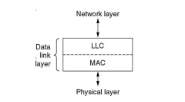
THE MEDIUM ACCESS CONTROL SUBLAYER
Data Link layer is divided into two sub layers:
1. Logical Link Control (LLC)-
is responsible for error control & flow control.
2. Medium Access Control (MAC)-
MAC is responsible for multiple access resolutions
‹#›

Slide 3
Types of channels
Channels are of two types
Point to point
Dedicated connection between two communication endpoints or nodes
Broadcast
Also called
Multiaccess Channels or Random Access Channels
Single channel is shared by multiple users
Determining who will use the channel next is a problem
‹#›

Slide 4
Broadcast Channels
Also called
Multiaccess Channels
Random Access Channels
Single channel is shared by multiple users .
Determining who will use the channel next is a problem
Medium Access Control (MAC) sublayer solves this problem and the protocols for channel allocation MAC protocols or multiple access protocols.
‹#›

Slide 5
THE CHANNEL ALLOCATION PROBLEM
In broadcast networks, single channel is shared by several stations.
This channel can be allocated to only one transmitting user at a time. There are two different methods of channel allocations:
1. Static Channel
2. Dynamic Channel Allocation
‹#›

Slide 6
THE CHANNEL ALLOCATION PROBLEM
1. Static Channel Allocation-
a single channel is divided among various users either on the basis of frequency (FDM) or on the basis of time (TDM).
In FDM, fixed frequency is assigned to each user, whereas, in TDM, fixed time slot is assigned to each user.
‹#›

Slide 7
THE CHANNEL ALLOCATION PROBLEM
2. Dynamic Channel Allocation-
no user is assigned fixed frequency or fixed time slot.
All users are dynamically assigned frequency or time slot, depending upon the requirements of the user
‹#›

Slide 8
MULTIPLE ACCESS PROTOCOLS
Protocols for dynamic channel allocation
Determines which stations can use the channel ie when station can transmit
‹#›

Slide 9
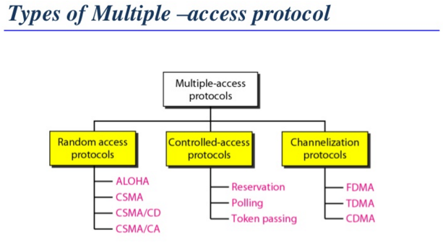
‹#›

Slide 10
Random Access Protocols
Random access protocols assign uniform priority to all connected nodes.
Any node can send data if the transmission channel is idle.
No fixed time or fixed sequence is given for data transmission.
‹#›

Slide 11
Controlled Access Protocols
Controlled access protocols allow only one node to send data at a given time.
Before initiating transmission, a node seeks information from other nodes to determine which station has the right to send.
This avoids collision of messages on the shared channel
‹#›

Slide 12
Channelization
Channelization are a set of methods by which the available bandwidth
is divided among the different nodes for simultaneous data transfer.
‹#›

Slide 13
ALOHA
Having the meaning “hello”
Uses ground based radio broadcasting
In this method, stations share a common channel.
When two stations transmit simultaneously, collision occurs which results in frame loss
‹#›

Slide 14
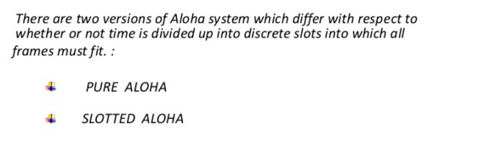
aloha
‹#›

Slide 15
Pure ALOHA
In pure ALOHA, stations transmit frames whenever they have data to send.
When two stations transmit simultaneously, will be collisions and the colliding frames will be damaged.
If the frame was destroyed, the sender just waits a random amount of time and sends it again.
To maximize throughput of ALOHA systems all frames have uniform size
‹#›

Slide 16
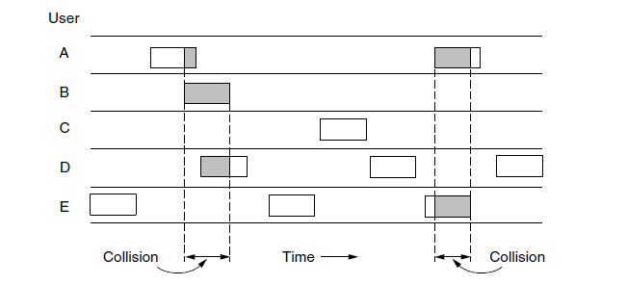
Frames in Pure ALOHA
‹#›

Slide 17
Pure ALOHA
Whenever two frames try to occupy the channel at the same time, there will be a collision and both will be garbled.
If the first bit of a new frame overlaps with just the last bit of a frame that has almost finished, both frames will be totally destroyed (i.e., have incorrect checksums) and both will have to be retransmitted later
‹#›

Slide 18
THROUGHPUT OF PURE ALOHA
Throughput ,S=G*P0
Where
G is the average number of old and new frame submissions
P₀ = probability that a frame does not suffer a collision
P0=e^{-2G}
And S=G*e^{-2G}
‹#›

Slide 19
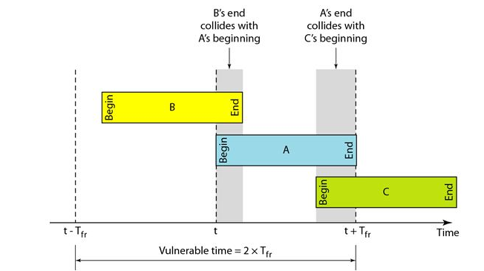
Vulnerable time:
The vulnerable time is in which there is a possibility of collision.
We assume that the stations send fixed-length frames with each frame taking Tfr S to send. The following figure shows the vulnerable time for station A.
vulnerable time for pure aloha is 2* Tfr
‹#›

Slide 20
ADVANTAGES OF PURE ALOHA
Superior to fixed assignment when there is a large no: of bursty stations
Adapts to varying number of stations

Slide 21
DISADVANTAGES OF PURE ALOHA
Theoretically proven output is only 18.4%
Requires queueing buffers for retransmission of packets

Slide 22
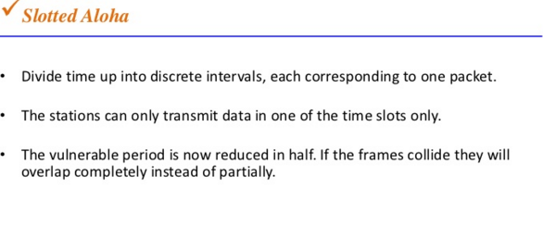
Slotted aloha
‹#›

Slide 23
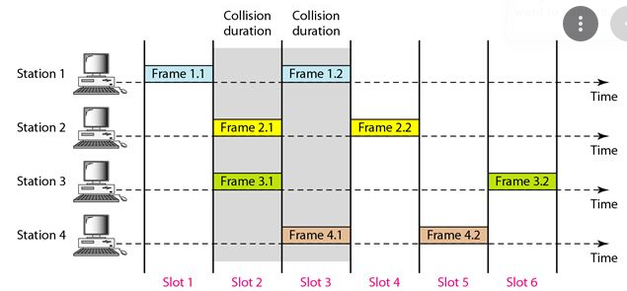
Slotted aloha
‹#›

Slide 24
Throughput of Slotted ALOHA
S = G e^{-G}
S peaks at G = 1
‹#›

Slide 25
Advantages of slotted Aloha
Double the efficiency of aloha
Adaptable to a changing station population
‹#›

Slide 26
Disadvantages of slotted Aloha
Theoretically proven maximum output is only 36.8%
Requires queueing buffers for retransmission of packets
Synchronization required
‹#›

Slide 27
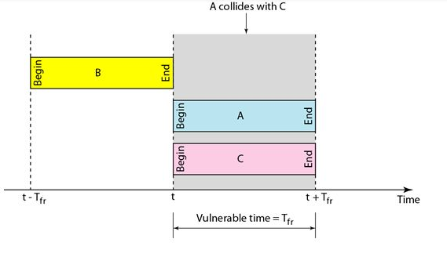
Vulnerable time of slotted aloha
Vulnerable time of slotted aloha is Tfr
‹#›

Slide 28
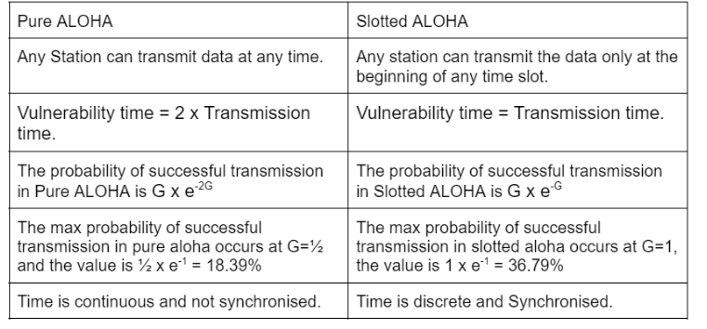
Differences between pure aloha and slotted aloha
‹#›

Slide 29
Carrier Sense Multiple Access (CSMA) Protocols
ALOHA does not listen to the channel before it transmits, ending up with poor performance
Carrier Sense Protocols
Stations listen the channel if there is any transmission going on before they transmit
If channel sensed idle: transmit entire pkt
If channel sensed busy, defer transmission
‹#›

Slide 30
Carrier Sense Multiple Access (CSMA) Protocols
CSMA uses electrical activity on cable to determine status.
When no station is sending then the channel doesn’t contain electrical signals.
During transmission the sender transmits electrical signals used to encode bits.
Although signals differ slightly from carrier wave they are informally called carrier.thus the name carrier sense multiple access protocols
‹#›

Slide 31
CSMA Protocols
There are different variations of the CSMA protocols:
1-persistent CSMA
Nonpersistent CSMA
p-persistent CSMA

Slide 32
1-persistent CSMA
The protocol:
Listens before transmits
If the medium is idle, transmit immediately
If the medium is busy, continue to listen until medium becomes idle, and then transmit immediately
If collision occurs, waits a random amount of time and starts all over again
It is called 1-persistent because the station transmits with a probability of 1 whenever it finds the channel idle.

Slide 33
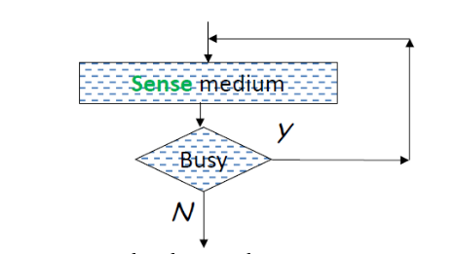
1 persistent CSMA
‹#›

Slide 34
1-persistent CSMA
Too selfish
there will always be a collision if two stations want to retransmit
If two or more stations becomes ready at the same time, collision guaranteed
Propagation delay has an important effect on the performance of this protocol
‹#›

Slide 35
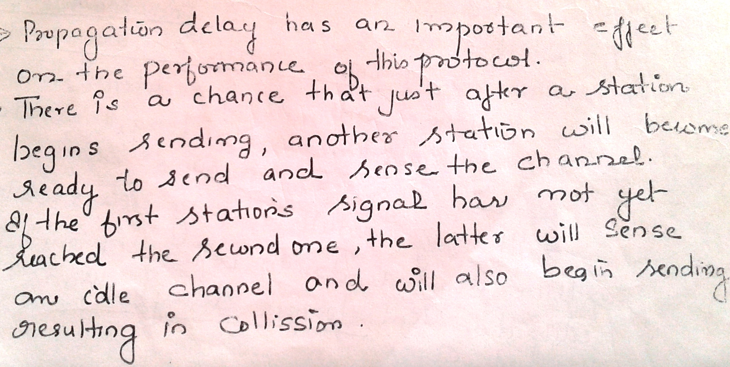
‹#›

Slide 36
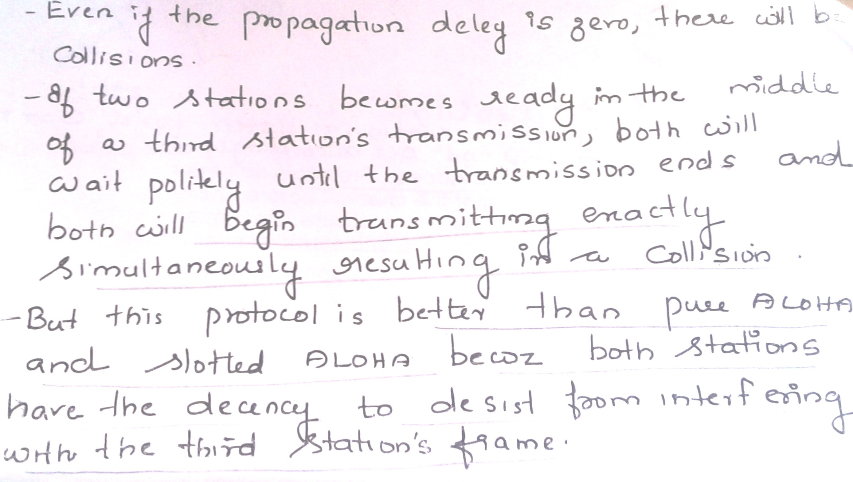
‹#›

Slide 37
Non-Persistent CSMA Protocol:
A station with frames to be sent, should sense the medium
If medium is idle, transmit; otherwise, go to 2
If medium is busy, (backoff) wait a random amount of time and repeat 1
Non-persistent Stations are deferential (respect others)
‹#›

Slide 38
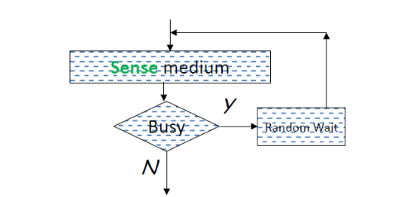
Non-Persistent CSMA
‹#›

Slide 39
Performance of Non-Persistent CSMA Protocol:
Random delays reduces probability of collisions because two stations with data to be transmitted will wait for different amount of times.
Bandwidth is wasted if waiting time (backoff) is large because medium will remain idle following end of transmission even if one or more stations have frames to send
‹#›

Slide 40
P-Persistent CSMA
Used in slotted systems
Combines the advantages of non-persistent and 1-persistent CSMA
In slotted channels every node will send only when it gets its timeslot .
when a station becomes ready to send it senses the channel and then if it is idle it will transmit at the probability P.
If the channel is also free but it has to check for one more condition whether that timeslot is allotted for that station if that timeslot is for that station then only it can send.
Otherwise it has to wait for its timeslot with a probability of 1-P
‹#›

Slide 41
P-persistent CSMA
Station wishing to transmit listens to the medium:
If medium idle,
transmit with probability (p), OR
wait one time unit (slot) with probability (1 – p), then repeat 1.
If medium busy, continuously listen until idle and repeat step 1
If a collision occurs, wait a random amount of time and go to step 1

Slide 42
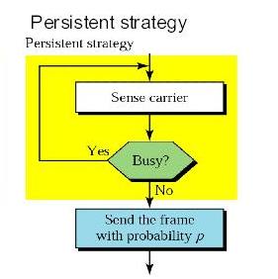
p-Persistent CSMA Protocol:
‹#›

Slide 43
Performance
Reduces the possibility of collisions like 1-persistent
Reduces channel idle time like nonpersistent
‹#›

Slide 44
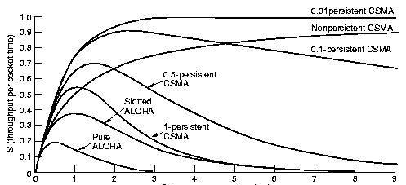
Channel Utilization for Random Access Protocols
‹#›

Slide 45
CSMA with Collision Detection (CSMA/CD)
Modification of CSMA
CSMA/CD is used to improve CSMA performance
It is used in LAN in MAC sub layer
It is the basis of popular ethernet LAN
‹#›

Slide 46
CSMA/CD (Collision Detection)
CSMA (all previous methods) has an inefficiency:
If a collision has occurred, the channel is unstable (the medium remains unusable) until colliding packets have been fully transmitted
CSMA/CD (Carrier Sense Multiple Access with Collision Detection) overcomes this as follows:
While transmitting, the sender is listening to medium for collisions.
Sender stops transmission if collision has occurred reducing channel wastage .
CSMA/CD is Widely used for bus topology LANs (IEEE 802.3, Ethernet).

Slide 47
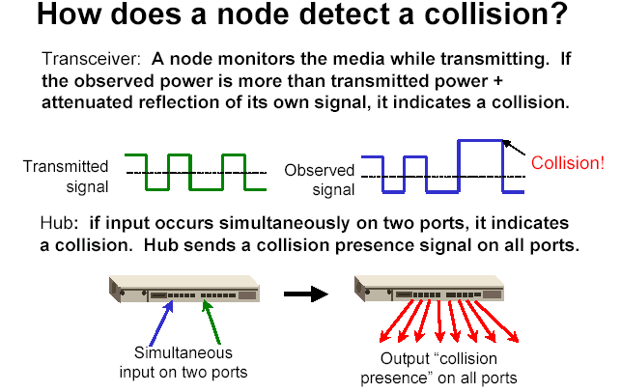
of its own
signal, it means collision occurred

Slide 48
CSMA/CD Protocol
Use one of the CSMA persistence algorithm (non-persistent, 1-persistent, p-persistent) for transmission
If a collision is detected by a station during its transmission then it should do the following:
Abort transmission and Transmit a jam signal (48 bit) to notify other stations about collision
After sending the jam signal, backoff (wait) for a random amount of time, then
Transmit the frame again

Slide 49
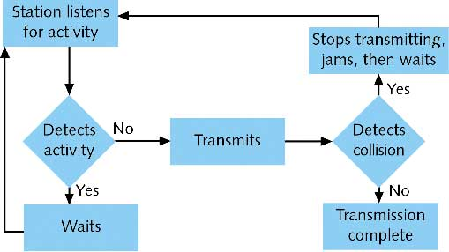
CSMA/CD

Slide 50
CSMA/CA
CSMA/CA protocol is used in wireless networks because they cannot detect the collision so the only solution is collision avoidance.
In contrast to CSMA/CD (Carrier Sense Multiple Access/Collision Detection) that deals with collisions after their occurrence, CSMA/CA prevents collisions prior to their occurrence.
‹#›

Slide 51
CSMA/CA-Algorithm
When a frame is ready, the transmitting station checks whether the channel is idle or busy.
If the channel is busy, the station waits until the channel becomes idle.
If the channel is idle, the station waits for an Inter-frame gap (IFG) amount of time and then sends the frame.
After sending the frame, it sets a timer.
The station then waits for acknowledgement from the receiver. If it receives the acknowledgement before expiry of timer, it marks a successful transmission.
Otherwise, it waits for a back-off time period and restarts the algorithm.
‹#›

Slide 52
CSMA/CA-
When a frame is ready, the transmitting station checks whether the channel is idle or busy.
If the channel is busy, the station waits until the channel becomes idle.
If the channel is idle, the station waits for an Inter-frame gap (IFG) amount of time and then sends the frame.
After sending the frame, it sets a timer.
The station then waits for acknowledgement from the receiver. If it receives the acknowledgement before expiry of timer, it marks a successful transmission.
Otherwise, it waits for a back-off time period and restarts the algorithm.
‹#›

Slide 53
CSMA/CA
CSMA/CA protocol is used in wireless networks because they cannot detect the collision so the only solution is collision avoidance.
CSMA/CA avoids the collisions using three basic techniques.
(i) Interframe space
(ii) Contention window
(iii) Acknowledgements
‹#›

Slide 54
Interframe space
Whenever the channel is found idle, the station does not transmit immediately. It waits for a period of time called interframe space (IFS).
When channel is sensed to be idle, it may be possible that same distant station may have already started transmitting and the signal of that distant station has not yet reached other stations.
Therefore the purpose of IFS time is to allow this transmitted signal to reach other stations.
If after this IFS time, the channel is still idle, the station can send, but it still needs to wait a time equal to contention time.
IFS variable can also be used to define the priority of a station or a frame.
‹#›

Slide 55
Contention Window
Contention window is an amount of time divided into slots.
A station that is ready to send chooses a random number of slots as its wait time.
The number of slots in the window changes according to the binary exponential back-off strategy. It means that it is set of one slot the first time and then doubles each time the station cannot detect an idle channel after the IFS time.
In contention window the station needs to sense the channel after each time slot.
If the station finds the channel busy, it does not restart the process. It just stops the timer & restarts it when the channel is sensed as idle.
‹#›

Slide 56
Acknowledgement
Despite all the precautions, collisions may occur and destroy the data.
The positive acknowledgment and the time-out timer can help guarantee that receiver has received the frame.
‹#›

